Slide 1




SYSTEM INFORMATION FOR ORDERING FLOWER BOARDS AND BOUQUETS
BY : KELOMPOK 01
FINAL PROJECT 2

Slide 2




TEAM MEMBERS
Albert
Angelica
Theresia
Saimarito
11321016
11321007
11321025
11321059
Project Manager
BY : KELOMPOK 01
FINAL PROJECT 2

Slide 3

OUTLINE
Website Development Goals
Current System
Target System
Main Function
Usecase diagram, BPMN & usecase scenario
ER-Diagram, CDM, & PDM
Class Diagram
Sequence Diagram
Test Script & Result
BY : KELOMPOK 01
FINAL PROJECT 2

Slide 4
FINAL PROJECT 2
KELOMPOK 01
GOALS
The purpose of the Flower and Bouquet Board Ordering information system is
Make it easier for sellers to sell products available in the store
Make it easier for sellers to manage sales data
Make it easier for buyers to make the order process

Slide 5
CURRENT SYSTEM
In the Toba district area, there are several shops that open flower and bouquet board ordering services. Meanwhile, not all people know the location of the flower and bouquet board sales shop. Order management is managed manually by recording orders and calculating in the shop seller's report book. This makes it difficult for sellers to manage sales and order data. Ordering flower boards or bouquets is done by customers at the location of the shop they want to buy. The customer will place an order by telling the order details such as the greeting, the name of the person concerned, the name of the sender, and the location of the recipient. The seller will record the order. After placing an order, the buyer will make a payment by giving a nominal amount of money according to the order made to the owner of the flower board shop.

Slide 6
TARGET SYSTEM
The information system for ordering flower board and bouquet is used by customers to order flower and bouquet boards. Before this website existed, customers who wanted to order flower board and bouquet had to visit the shop or had to find the contact number of the shop owner if the customer could not visit the shop directly. In addition, the seller also manages sales and income data. With the creation of a flower board and bouquet ordering information system, it is hoped that it can provide great benefits to the community, especially for customers who want to order products around Toba Regency. This information system makes it easier for customers to get product information sold by the store, place orders and make payments. To place an order, customers will only fill in the form that has been provided for the purposes of information that will be made on flower board and bouquet. This information system provides information on shops that have been registered by sellers, store addresses, products sold by the store, seller contact numbers, and product reviews from other customers which can help prospective customers to find out the quality of products based on customer reviews that have made orders.

Slide 7

1
Authentication
Search
Filter
Manage store
Manage products
Manage orders
Order verification
Provide review
View order recapture
View sales recapitulation
Deactivate store
2
3
4
MAIN
FUNCTION
5
6
7
8
9
10
11

Slide 8
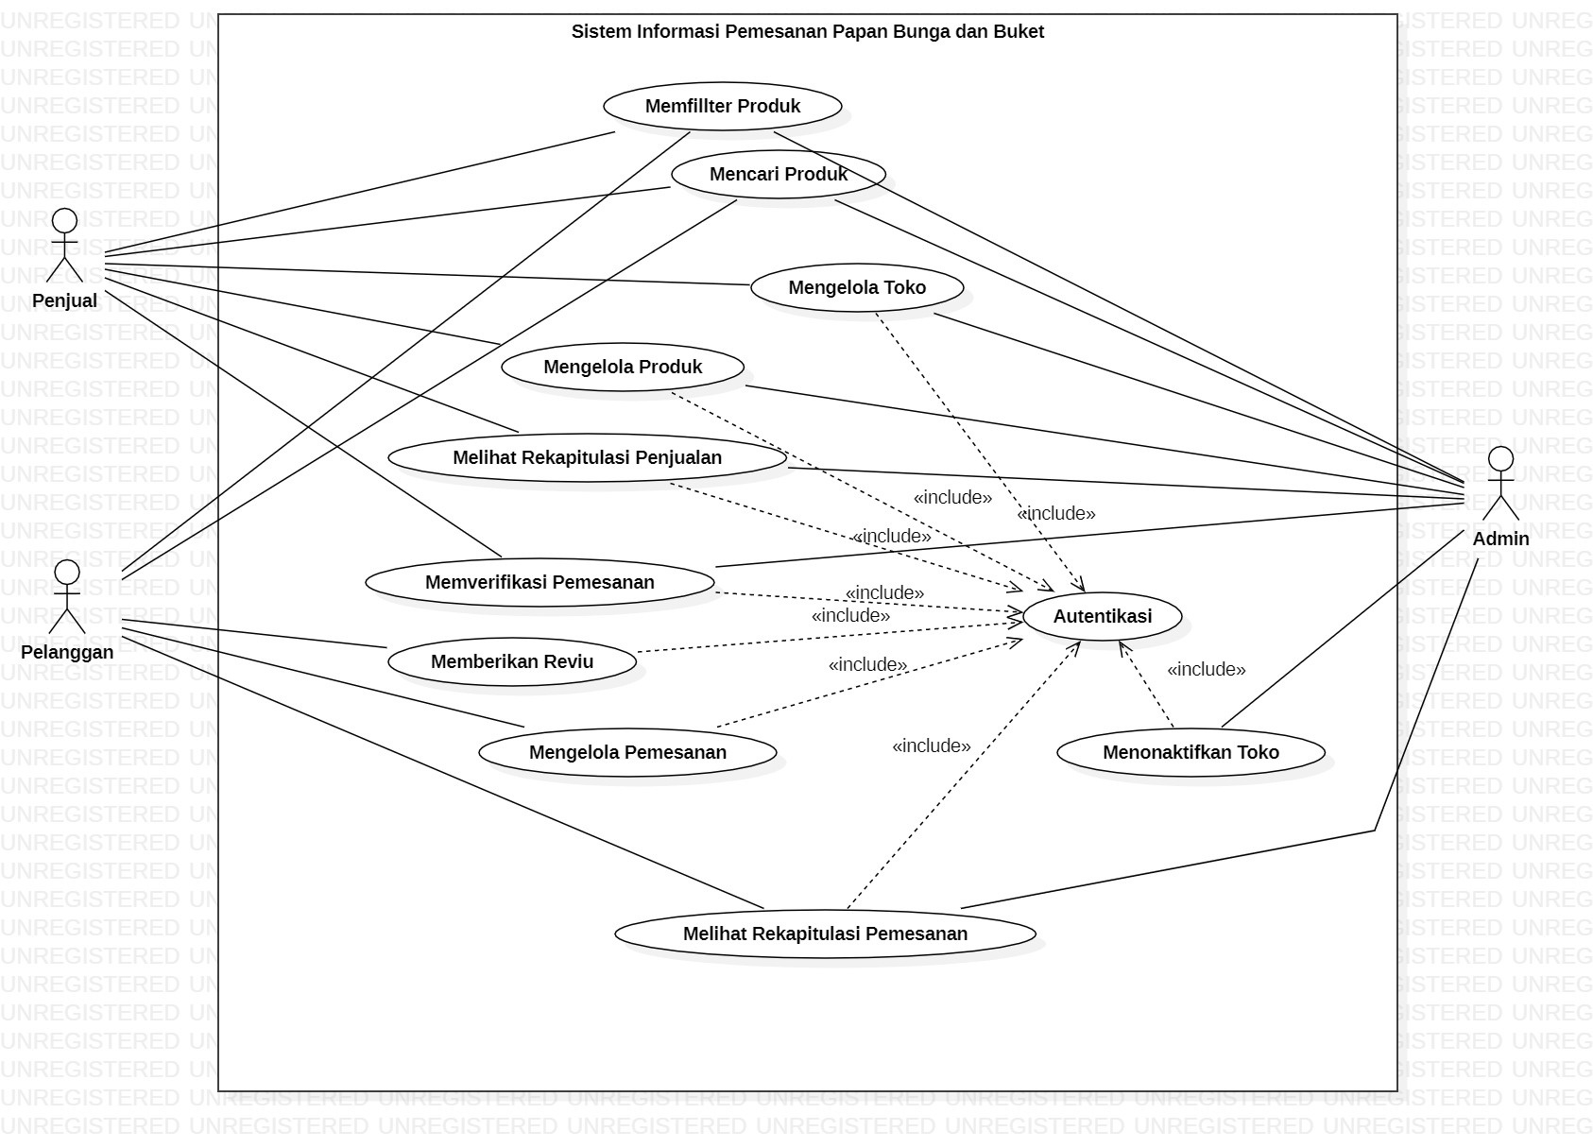
USE CASE DIAGRAM
BY : KELOMPOK 01
FINAL PROJECT 2

Slide 9
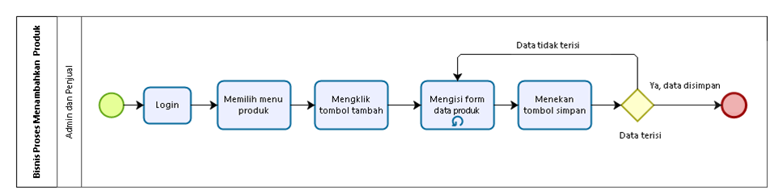
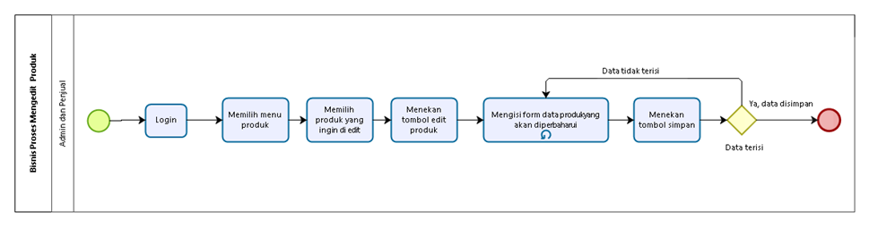

MANAGE PRODUCT
ADDING PRODUCT
EDIT PRODUCT

Slide 10
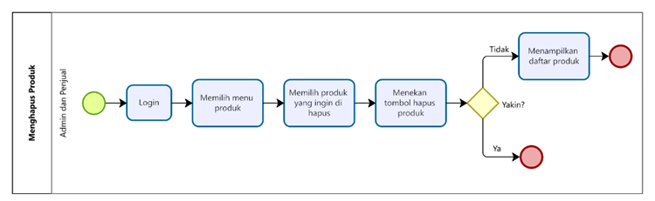
MANAGE PRODUCT
DELETING PRODUCT

Slide 11
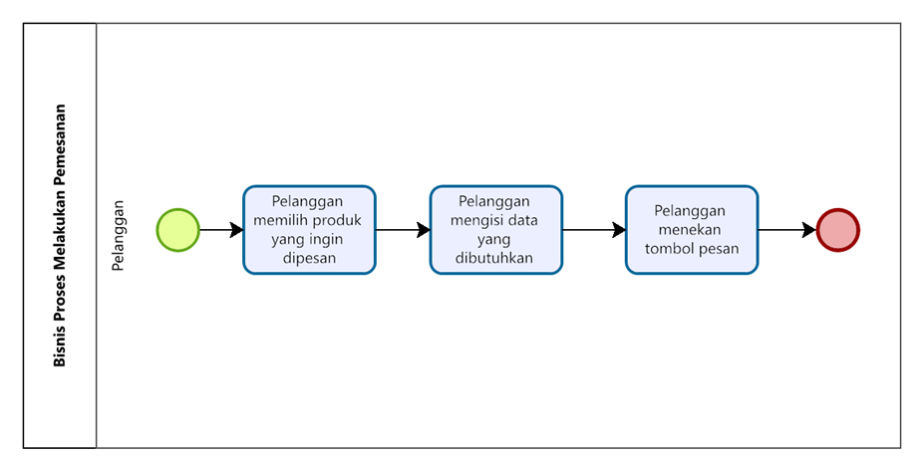
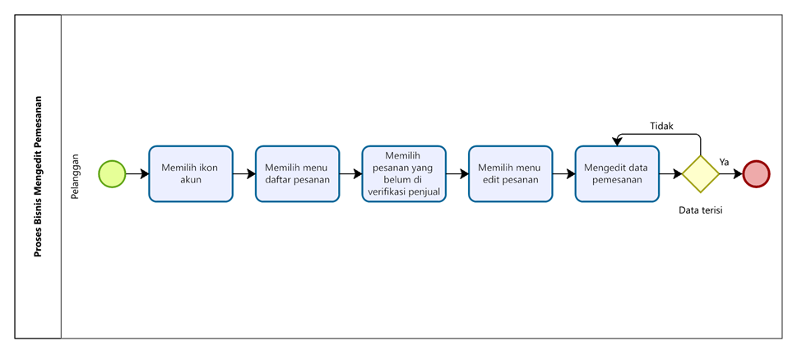
MANAGE ORDERS
ADDING ORDERS
EDIT ORDERS

Slide 12
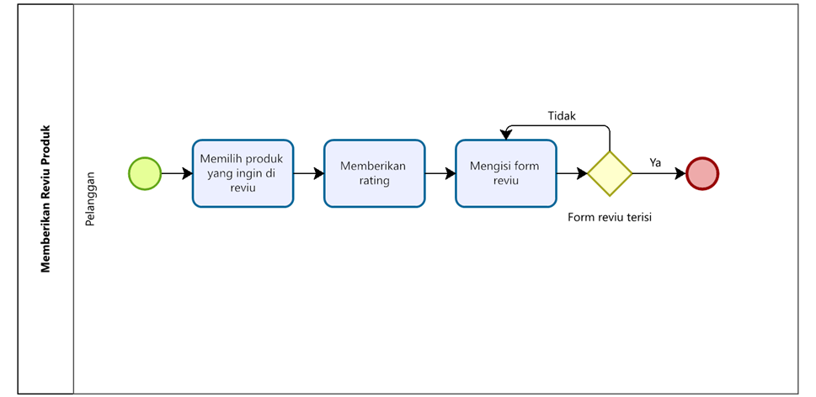
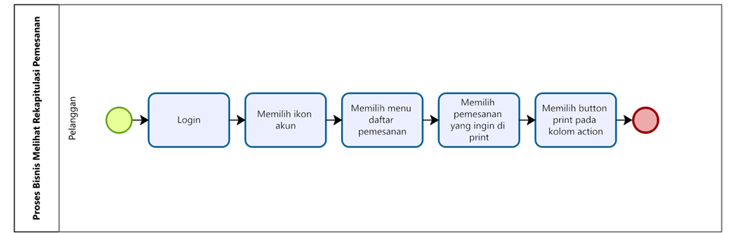
PROVIDE REVIEW
VIEW ORDER RECAPTURE

Slide 13
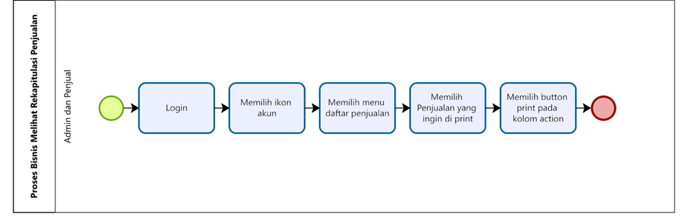
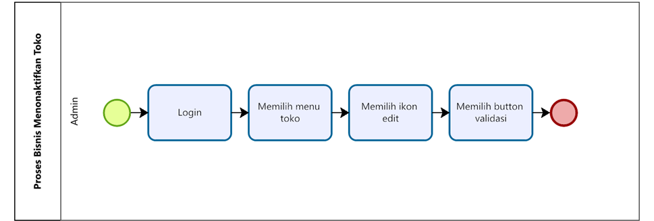
VIEW SALES RECAPITULATION
DEACTIVATE STORE

Slide 14
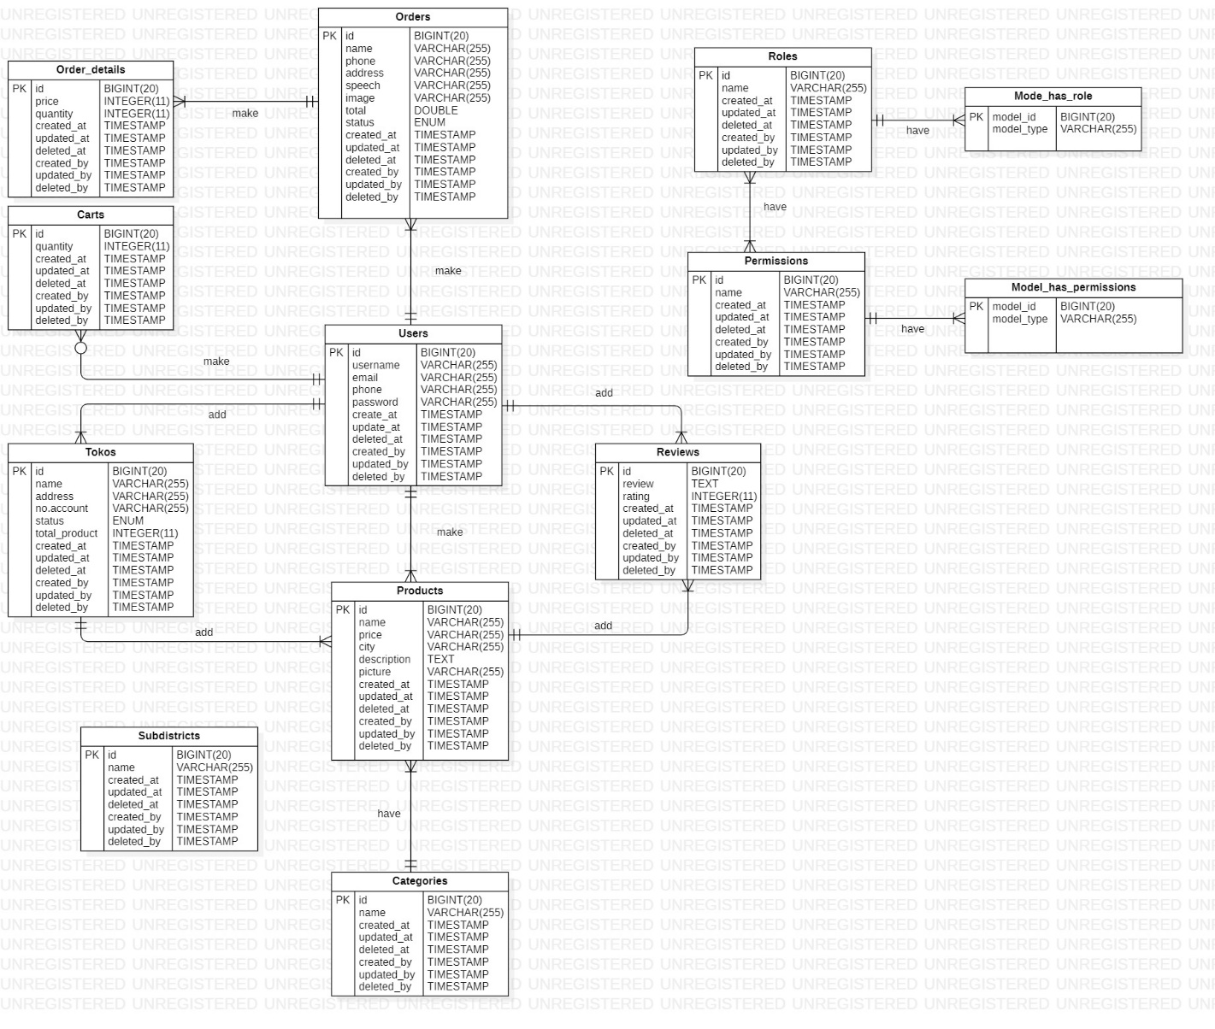
ER DIAGRAM
BY : KELOMPOK 01
FINAL PROJECT 2

Slide 15
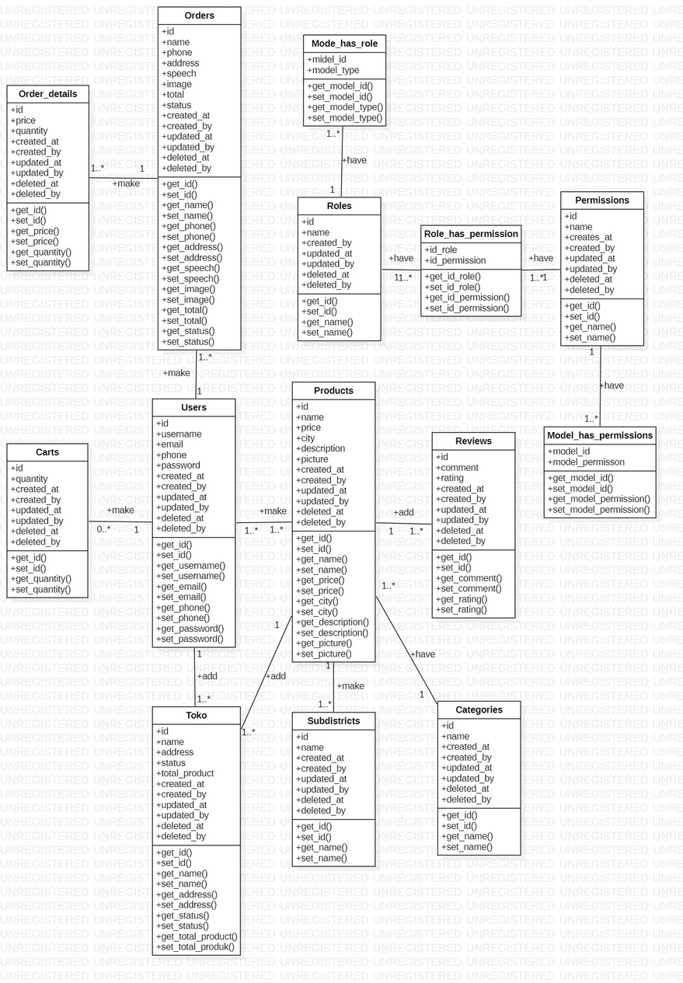
CLASS DIAGRAM
BY : KELOMPOK 01
FINAL PROJECT 2

Slide 16
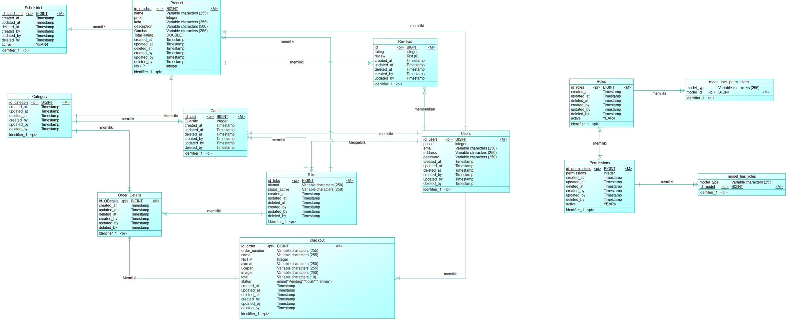
CONCEPTUAL DATA MODEL
BY : KELOMPOK 01
FINAL PROJECT 2

Slide 17
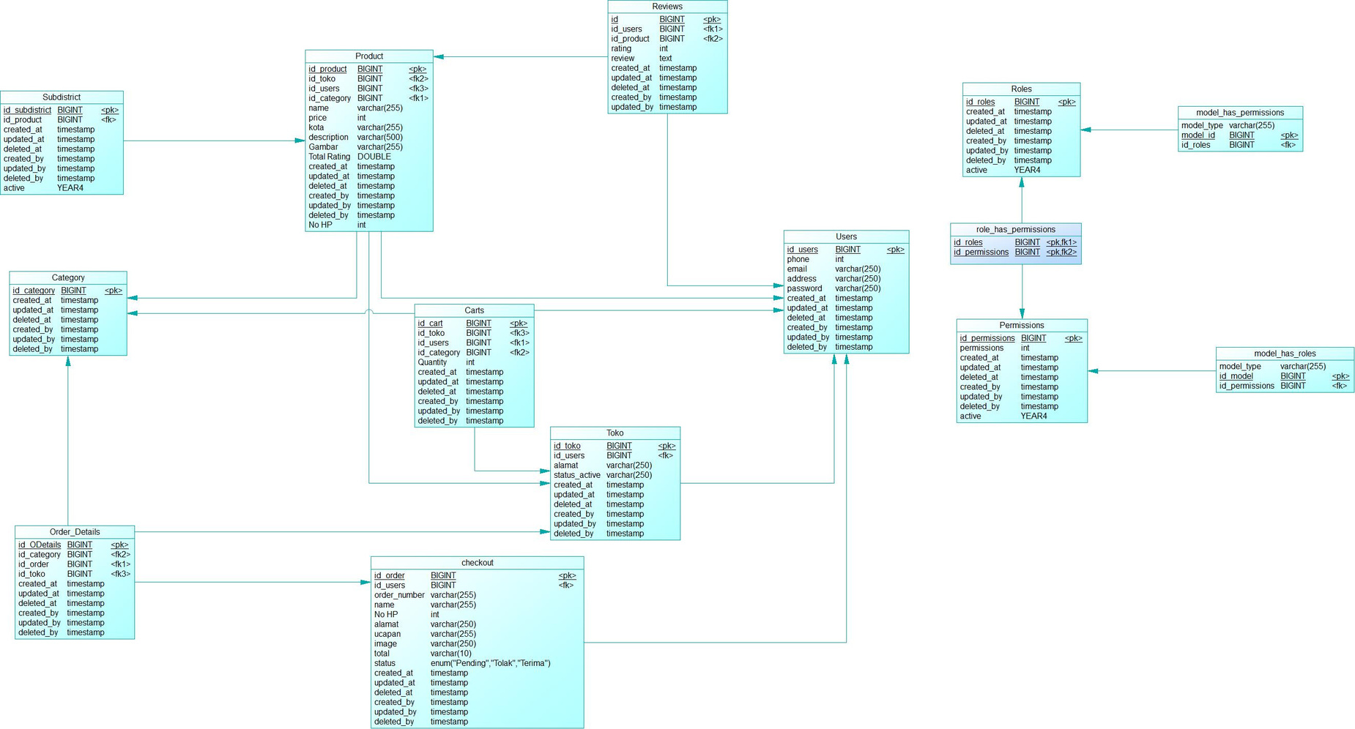
PHYSICAL DATA MODEL
BY : KELOMPOK 01
FINAL PROJECT 2

Slide 18
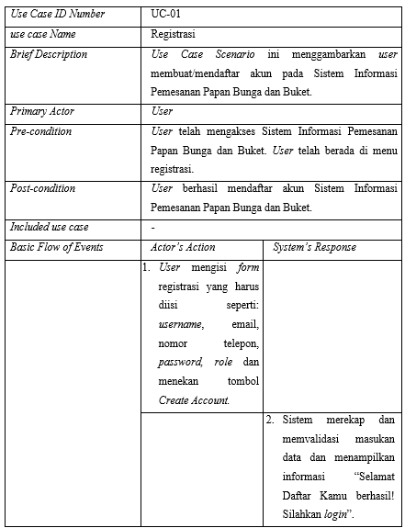
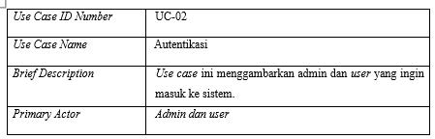
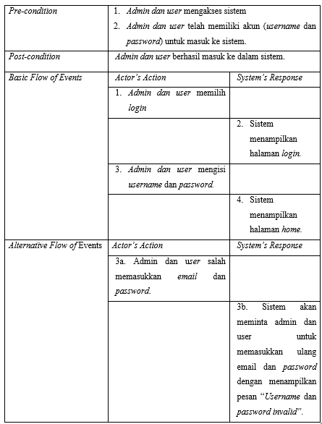
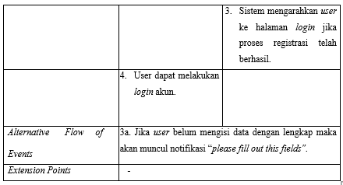
Registration
Login
USE CASE SCENARIO

Slide 19
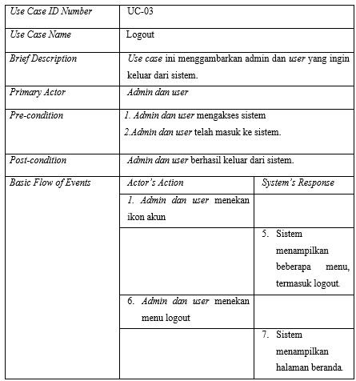
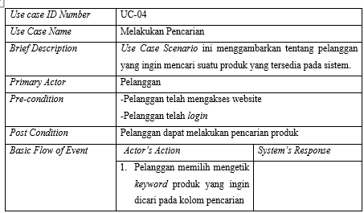
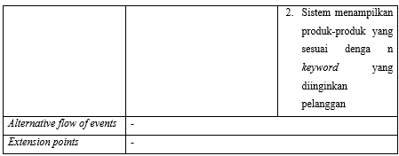
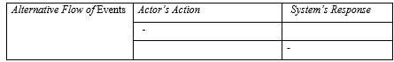
Logout
Search
USE CASE SCENARIO

Slide 20
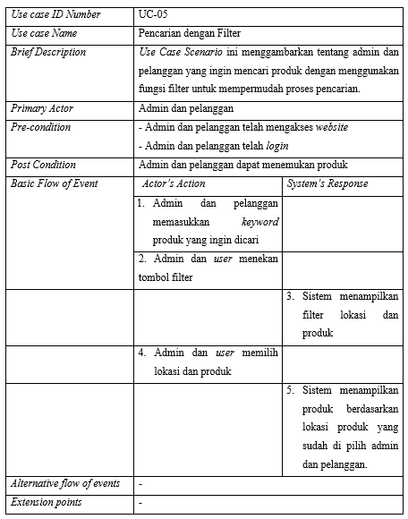
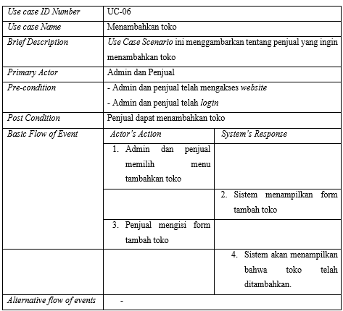
USE CASE SCENARIO
Filter
Add Store

Slide 21
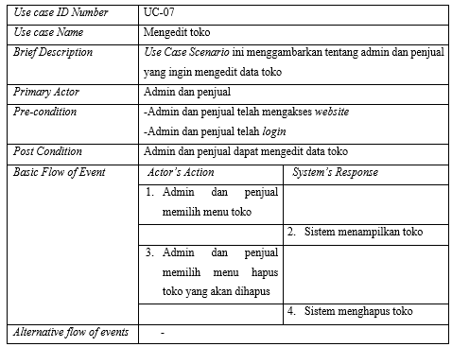
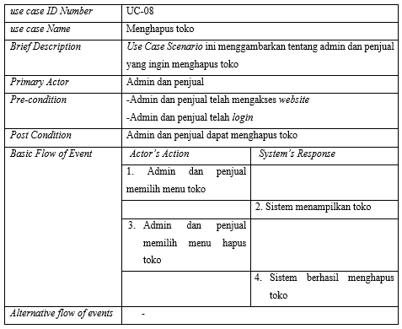
USE CASE SCENARIO
Edit Store
Deleting Store

Slide 22
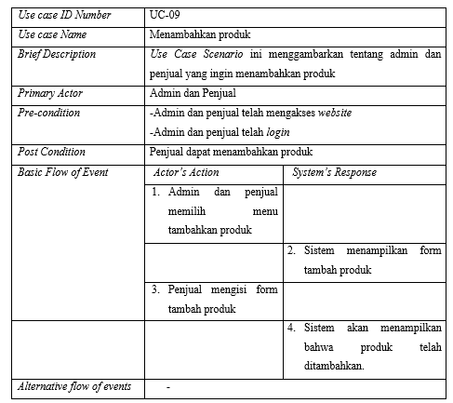
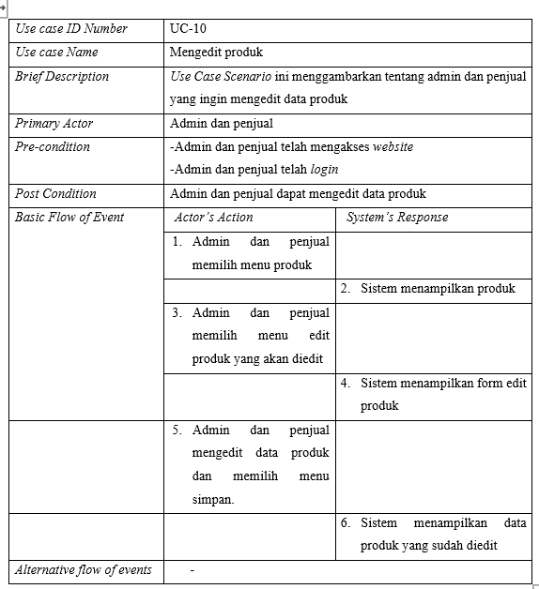
USE CASE SCENARIO
Adding Product
Edit Product

Slide 23
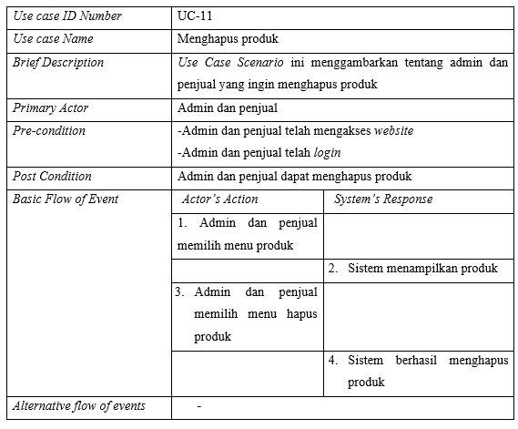
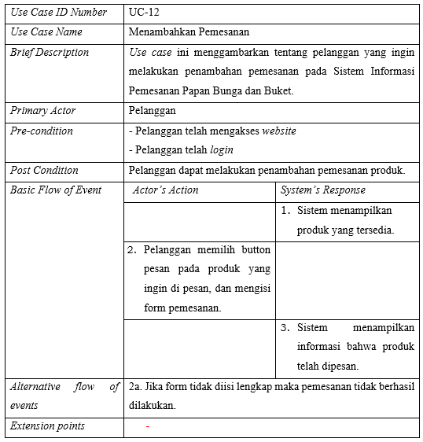
USE CASE SCENARIO
Deleting Product
Adding Orders

Slide 24
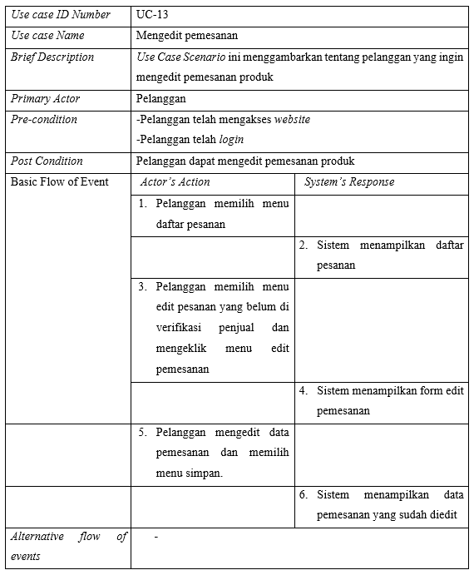
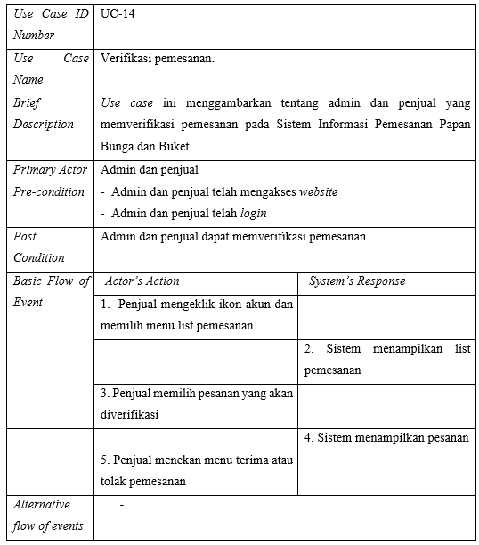
USE CASE SCENARIO
Edit Orders
Order verification

Slide 25
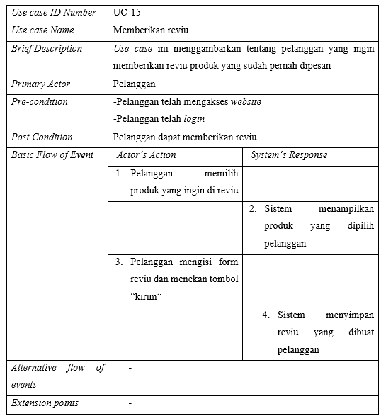
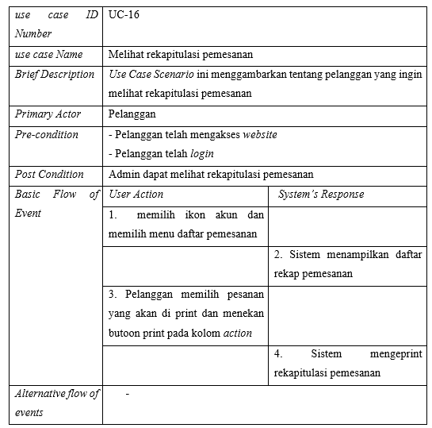
USE CASE SCENARIO
Provide review
View order recapture

Slide 26
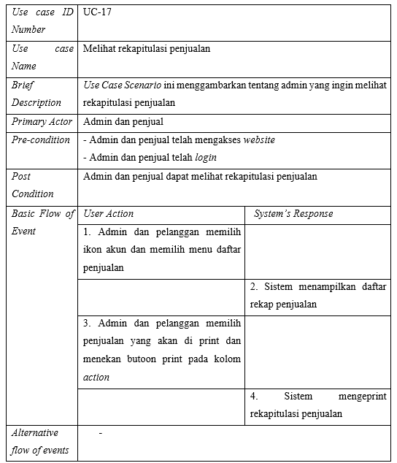
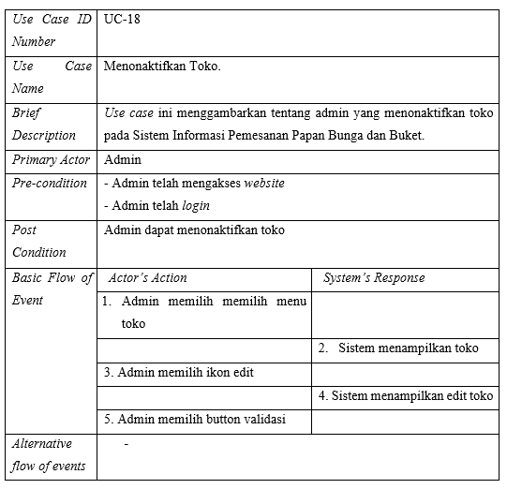
USE CASE SCENARIO
View sales recapitulation
Deactivate store

Slide 27
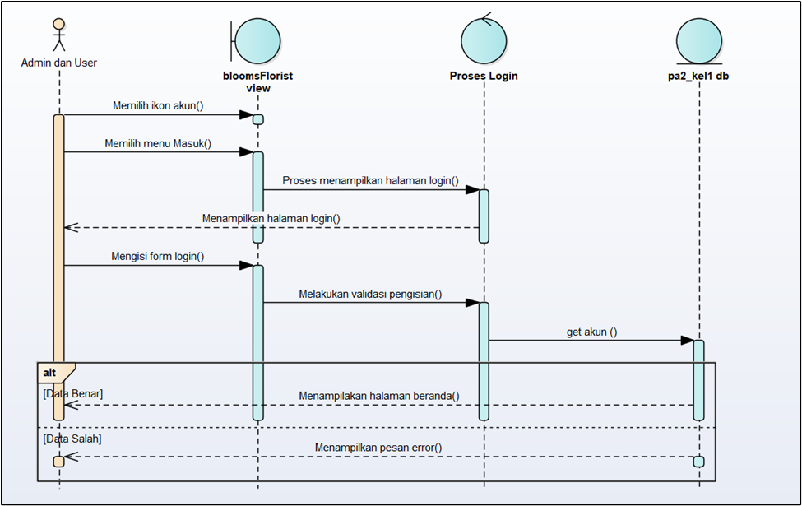
SEQUENCE
DIAGRAM
Login

Slide 28
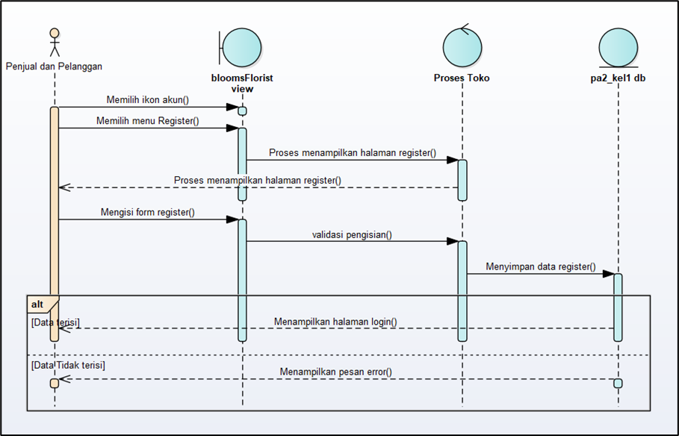
SEQUENCE
DIAGRAM
Registration

Slide 29
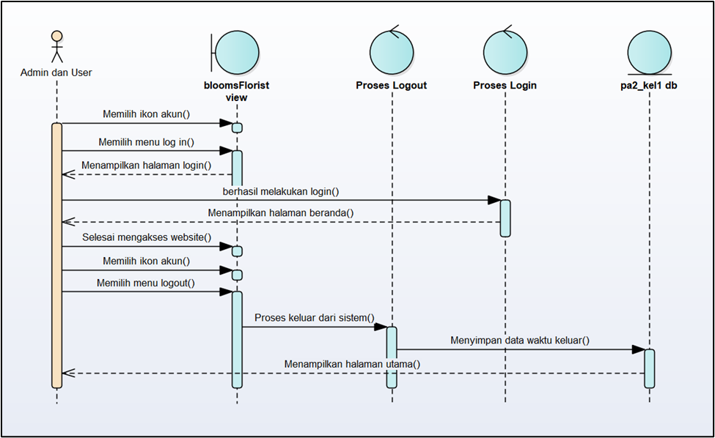
SEQUENCE
DIAGRAM
Logout

Slide 30
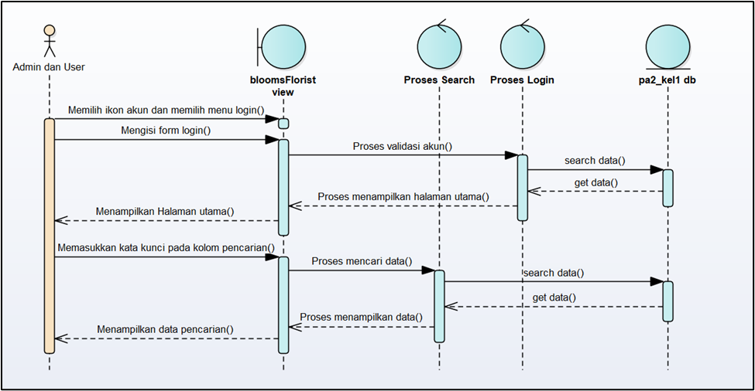
SEQUENCE
DIAGRAM
Melakukan Pencarian

Slide 31
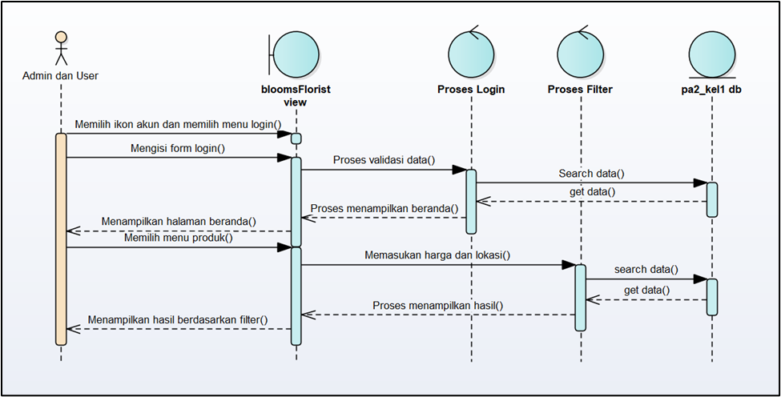
SEQUENCE
DIAGRAM
Melakukan Pencarian Melalui Filter

Slide 32
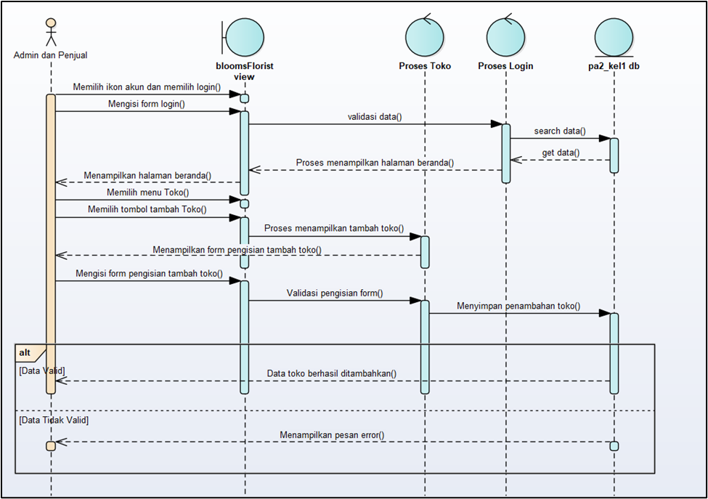
SEQUENCE
DIAGRAM
Menambah Toko

Slide 33
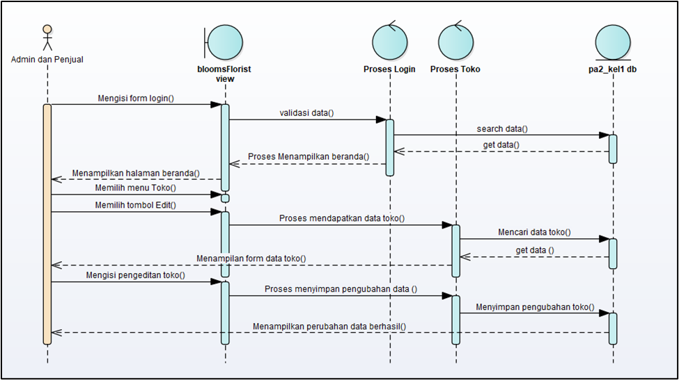
SEQUENCE
DIAGRAM
Mengedit Toko

Slide 34
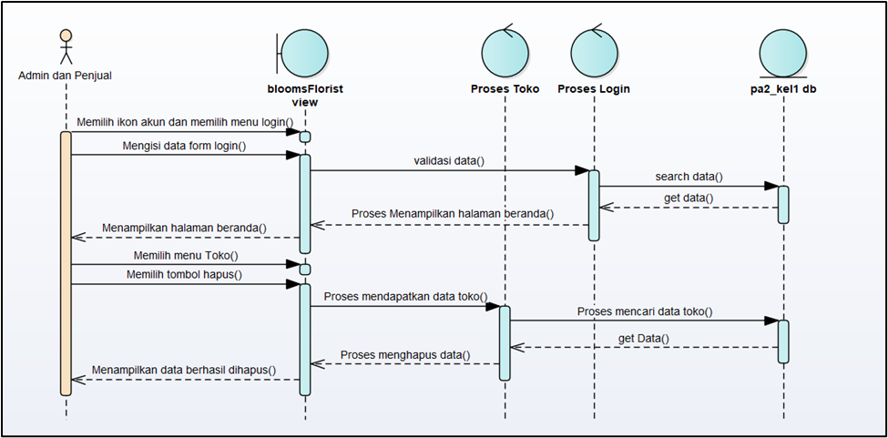
SEQUENCE
DIAGRAM
Menghapus Toko

Slide 35
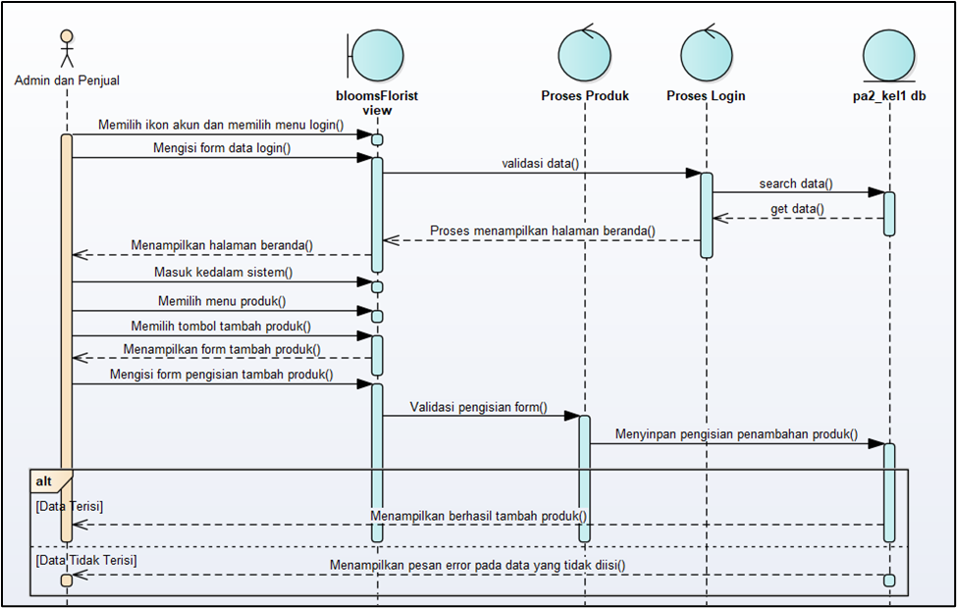
SEQUENCE
DIAGRAM
Menambah Produk

Slide 36
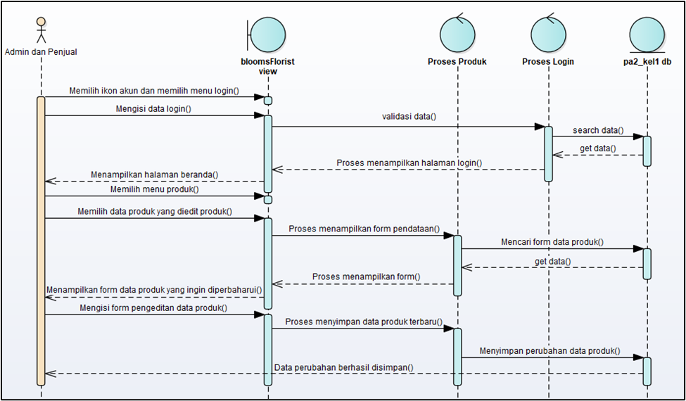
SEQUENCE
DIAGRAM
Mengedit Produk

Slide 37
SEQUENCE
DIAGRAM
Menghapus Produk

Slide 38
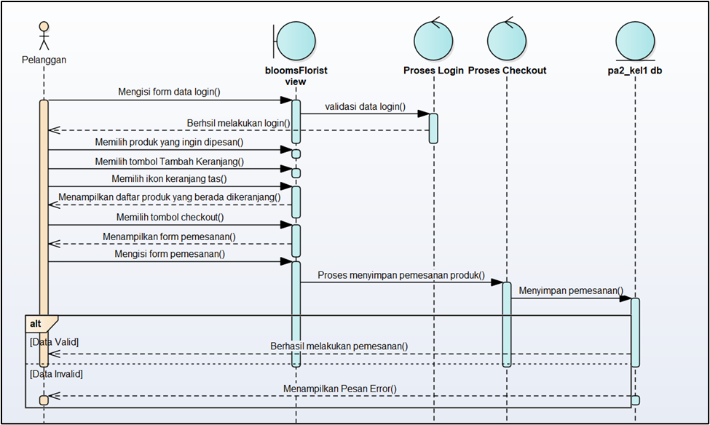
SEQUENCE
DIAGRAM
Melakukan Pemesanan

Slide 39
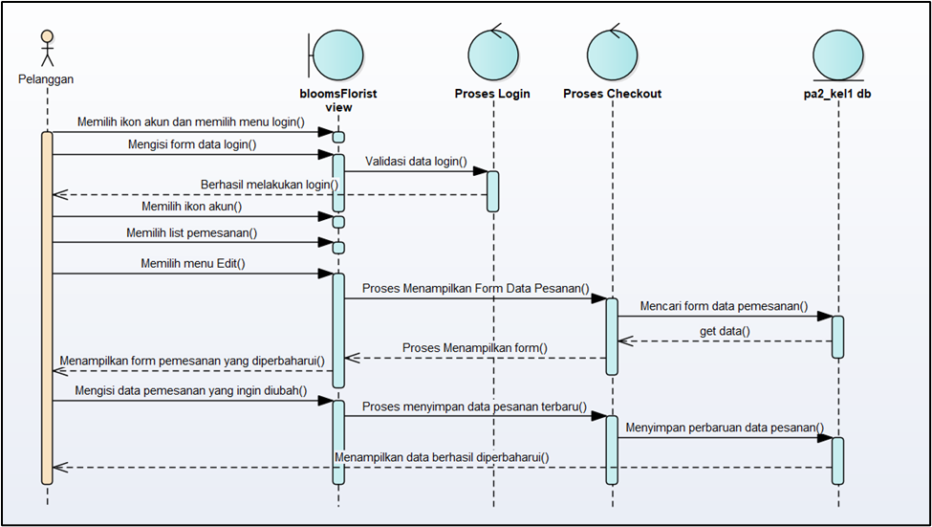
SEQUENCE
DIAGRAM
Mengedit Pemesanan

Slide 40
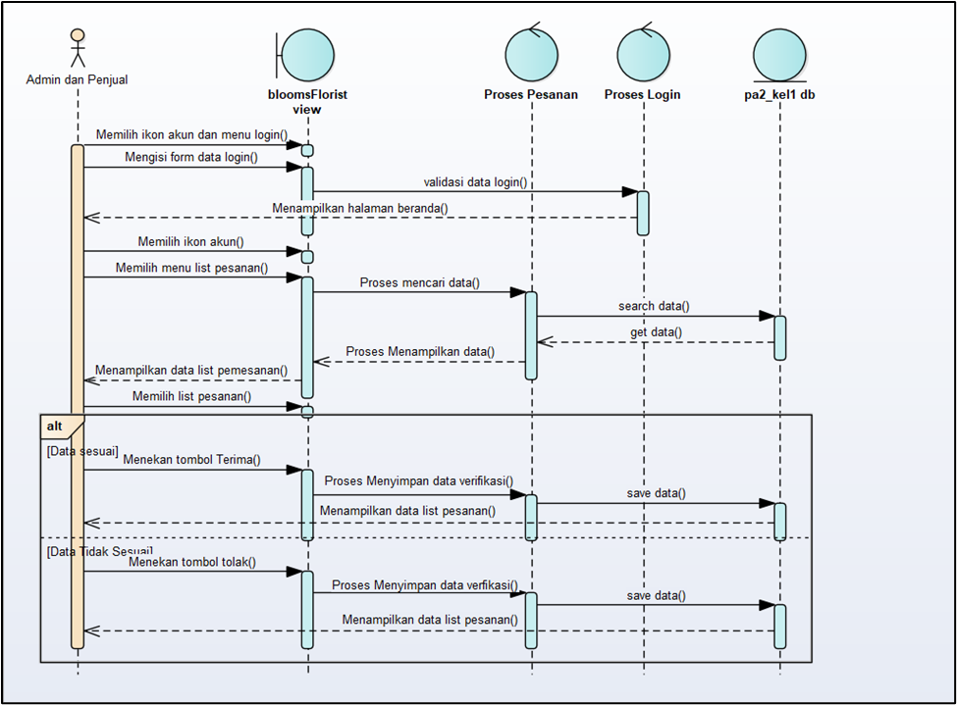
SEQUENCE
DIAGRAM
Verifikasi Pemesanan

Slide 41
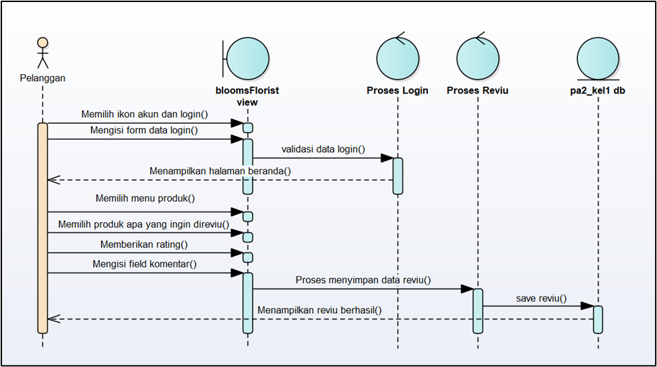
SEQUENCE
DIAGRAM
Memberikan Reviu

Slide 42

SEQUENCE
DIAGRAM
Rekapitulasi Pemesanan

Slide 43

SEQUENCE
DIAGRAM
Rekapitulasi Penjulan

Slide 44

SEQUENCE
DIAGRAM
Menonaktifkan Toko

Slide 45

DEMO
BY : KELOMPOK 01
FINAL PROJECT 2

Slide 46

THANK
YOU
BY : KELOMPOK 01
FINAL PROJECT 2

